Slide 1
Chapter 13 Abstract Classes and Interfaces

Slide 2
Abstract Classes
    In inheritance, classes become more specific and concrete with each new subclass.
      GeometricObject
      Rectangle, Circle
    If you move from a subclass back up to a superclass, the classes become more general and less specific.

Slide 3
Abstract Classes
    Class design should ensure that a superclass contains common features of its subclasses.
    Sometimes a superclass is so abstract that it cannot be used to create any specific instances.
      Creating a GeometricObject ?
    Such a class is referred to as an abstract class.

Slide 4
Abstract Classes
    Both Circle and Rectangle contain the getArea() and getPerimeter() methods for computing the area and perimeter of a circle and a rectangle.
    Since you can compute areas and perimeters for all geometric objects, it is better to define the getArea() and getPerimeter() methods in the GeometricObject class.

Slide 5
Abstract Classes
    However, these methods cannot be implemented in the GeometricObject class, because their implementation depends on the specific type of geometric object.
    Such methods are referred to as abstract methods and are denoted using the abstract modifier in the method header.
    After you define the methods in GeometricObject, it becomes an abstract class. Abstract classes are denoted using the abstract modifier in the class header.

Slide 6
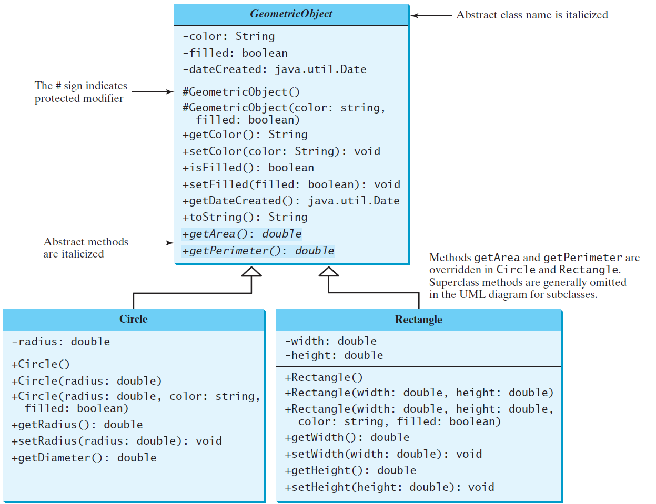
Abstract Classes and Abstract Methods
GeometricObject
Circle
Rectangle
TestGeometricObject
Run

Slide 7
abstract method in abstract class
An abstract method cannot be contained in a nonabstract class.
If a subclass of an abstract superclass does not implement all the abstract methods, the subclass must be defined abstract.
In other words, in a nonabstract subclass extended from an abstract class, all the abstract methods must be implemented, even if they are not used in the subclass.

Slide 8
object cannot be created from abstract class
An abstract class cannot be instantiated using the new operator.
We can still define its constructors, which are invoked in the constructors of its subclasses.
  For instance, the constructors of GeometricObject are invoked in the Circle class and the Rectangle class.

Slide 9
abstract class without abstract method
A class that contains abstract methods must be abstract.
However, it is possible to define an abstract class that contains no abstract methods. In this case, you cannot create instances of the class using the new operator.
This class is used as a base class for defining a new subclass.

Slide 10
superclass of abstract class may be concrete
A subclass can be abstract even if its superclass is concrete.
For example, the Object class is concrete, but its subclasses, such as GeometricObject, may be abstract.

Slide 11
abstract class as type
You cannot create an instance from an abstract class using the new operator, but an abstract class can be used as a data type.
GeometricObject c = new Circle(2);
The following statement, which creates an array whose elements are of GeometricObject type, is correct.
GeometricObject[] geo = new GeometricObject[10];

Slide 12
*Case Study: Payroll System Using Polymorphism
A company pays its employees on a weekly basis.
The employees are of four types:
  Salaried employees are paid a fixed weekly salary regardless of the number of hours worked,
  Hourly employees are paid by the hour and receive overtime pay (i.e., 1.5 times their
  hourly salary rate) for all hours worked in excess of 40 hours,
  Commission employees are paid a percentage of their sales and
  Base-salaried commission employees receive a base salary plus a percentage of their sales.
For the current pay period, the company has decided to reward salaried-commission employees by adding 10% to their base salaries. The company wants to write an application that performs its payroll calculations polymorphically.
*Java : How To Program P.J. Deitel, H.M. Deitel., 9th ed.

Slide 13
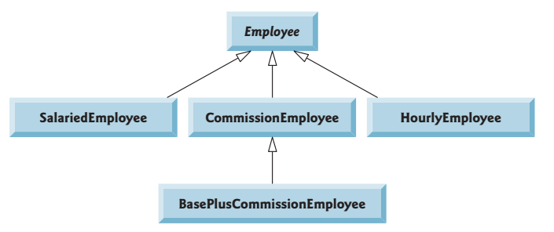
*Case Study: Payroll System Using Polymorphism
*Java : How To Program P.J. Deitel, H.M. Deitel., 9th ed.

Slide 14
Abstract Superclass Employee
a constructor that takes the first name, last
name and social security number as arguments
get/set methods
Method toString()
abstract method earnings

Slide 15
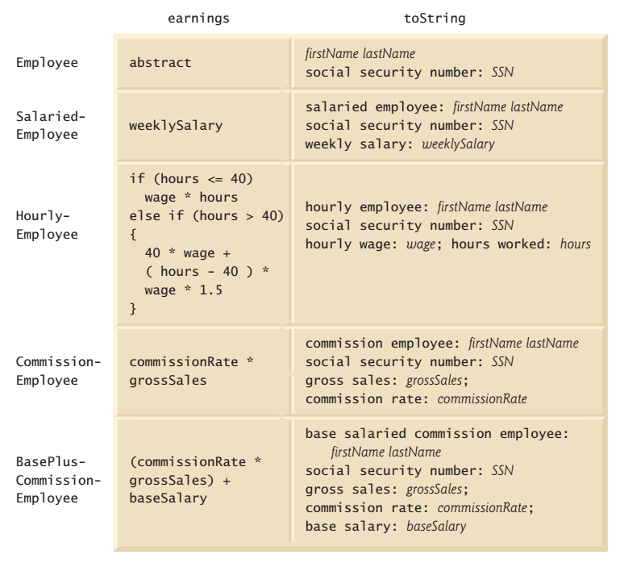
earnings and toString methods in class hierarchy

Slide 16
Concrete Subclass SalariedEmployee
SalariedEmployee extends class Employee
constructor that takes a first name, a last
name, a social security number and a weekly
salary as arguments
get/set methods
Method toString()
Method earnings

Slide 17
Concrete Subclass HourlyEmployee
HourlyEmployee extends class Employee
constructor that takes a first name, a last
name, a social security number, an hourly
wage and the number of hours worked.
get/set methods
Method toString()
Method earnings

Slide 18
Concrete Subclass CommissionEmployee
CommissionEmployee extends class Employee
constructor that takes a first name, a last
name, a social security number, a sales
amount and a commission rate;
get/set methods
Method toString()
Method earnings

Slide 19
Indirect Concrete Subclass BasePlusCommissionEmployee
BasePlusCommissionEmployee extends class
CommissionEmployee
constructor that takes a first name, a last
name, a social security number, a sales
amount, a commission rate and a base salary.
get/set methods
Method toString()
Method earnings

Slide 20

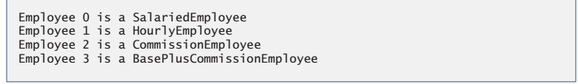
Sample Output:

Slide 21
Abstract Classes & Methods Review
What is an abstract method?
What is an abstract class?
Answer the following questions (True/False)?
  An abstract class can be instantiated.
  An abstract class must have at least one abstract method.
  The subclasses of an abstract class must implement all the abstract methods defined in the superclass.
    What happens if the subclass of an abstract class does not implement all the abstract methods?
  A subclass of a concrete class cannot be abstract.
  An abstract class cannot be used as a data type.

Slide 22
Interfaces
What is an interface?
Why is an interface useful?
How do you define an interface?
How do you use an interface?

Slide 23
What is an interface?
Why is an interface useful?
An interface is a class-like construct that contains only constants and abstract methods.
In many ways, an interface is similar to an abstract class, but the intent of an interface is to specify common behavior for objects of related classes or unrelated classes.
For example, you can specify that the objects are comparable, edible, cloneable using appropriate interfaces.

Slide 24
Define an Interface
To distinguish an interface from a class, Java uses the following syntax to define an interface:
public interface InterfaceName {
constant declarations;
abstract method signatures;
}
Example:
public interface Edible {
/** Describe how to eat */
public abstract String howToEat();
}

Slide 25
Interface is a Special Class
An interface is treated like a special class in Java.
Each interface is compiled into a separate bytecode file, just like a regular class.
Like an abstract class, you cannot create an instance from an interface using the new operator.
You can use an interface as a data type for a variable, as the result of casting, and so on.

Slide 26
Example
You can now use the Edible interface to specify whether an object is edible.
This is accomplished by letting the class for the object implement this interface using the implements keyword.
For example, the classes Chicken and Fruit implement the Edible interface (See TestEdible).
class Fruit implements Edible

Slide 27
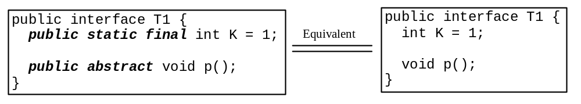
Omitting Modifiers in Interfaces
  All data fields are public final static in an interface.
  All methods are public abstract in an interface.
  For this reason, these modifiers can be omitted, as shown below:
  A constant defined in an interface can be accessed using syntax InterfaceName.CONSTANT_NAME (e.g., T1.K).

Slide 28
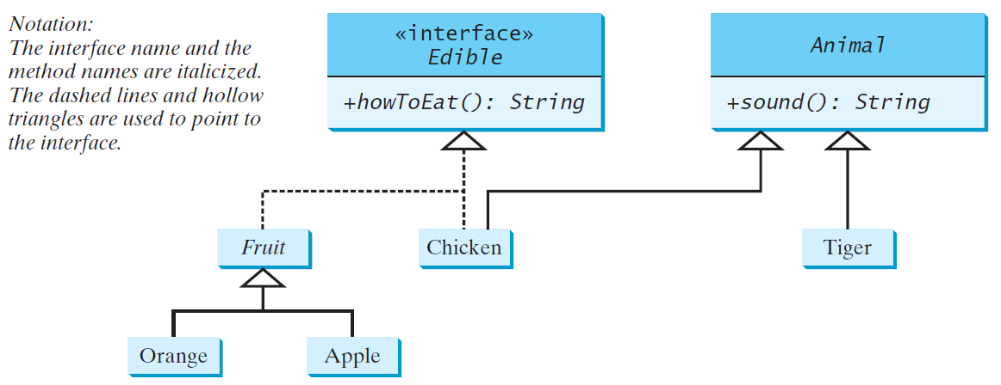
Example
Edible
TestEdible
Run

Slide 29
Exercise #1: What is wrong in the following code?
interface A {
void m1();
}
class B implements A {
void m1() {
System.out.println("m1");
}
}
attempting to assign weaker access privileges;

Slide 30
The Comparable Interface
The Comparable interface defines the compareTo method for comparing objects.
// This interface is defined in java.lang package
package java.lang;
public interface Comparable<E> {
public int compareTo(E o);
}
Notes:
- Suppose you want to design a generic method to find the larger of two objects of the same type, such as two students, two dates, two circles, two rectangles, or two squares.
- In order to accomplish this, the two objects must be comparable, so the common behavior for the objects must be comparable.

Slide 31
The Comparable Interface
public interface Comparable<E> {
public int compareTo(E o);
}
The Comparable interface is a generic interface.
The generic type E is replaced by a concrete type
when implementing this interface.

Slide 32
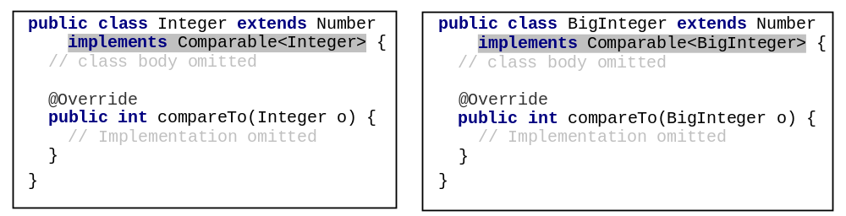
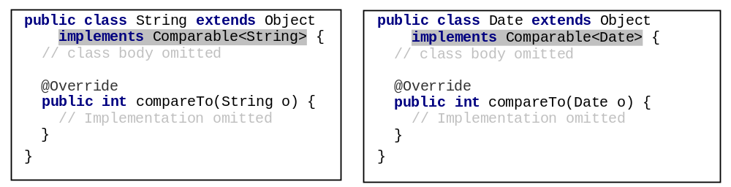
Integer and BigInteger Classes
String and Date Classes

Slide 33
Example
Use the compareTo method to compare two numbers, two strings, and two dates. For example, the following code
1 System.out.println(new Integer(3).compareTo(new Integer(5)));
2 System.out.println("ABC".compareTo("ABE"));
3 java.util.Date date1 = new java.util.Date(2013, 1, 1);
4 java.util.Date date2 = new java.util.Date(2012, 1, 1);
5 System.out.println(date1.compareTo(date2));
displays
-1 // 3 is less then 5
-2 // ABC is less than ABE
1 // date1 is greater than date2.

Slide 34
Generic sort Method
Let n be an Integer object, s be a String object, and d be a Date object. All the following expressions are true.
The java.util.Arrays.sort(array) method requires that the elements in an array are instances of Comparable<E>.

Slide 35
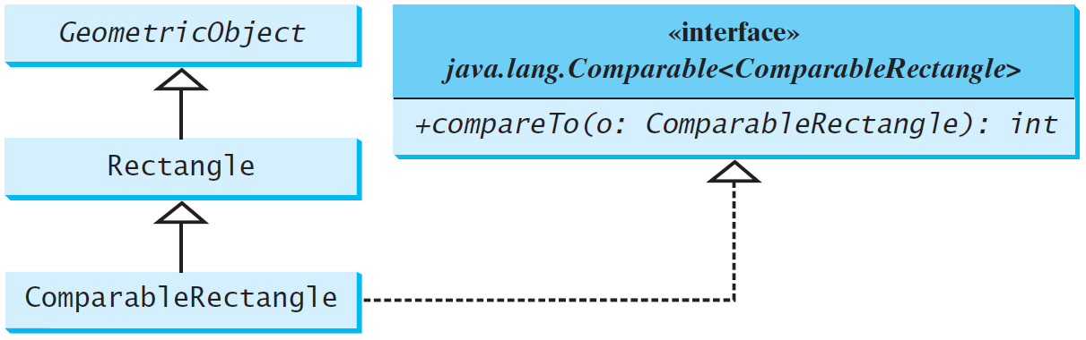
Defining Classes to Implement Comparable
ComparableRectangle
SortRectangles
Run
Notes:
You cannot use the sort method to sort an array of Rectangle objects, because Rectangle does not implement Comparable. However, you can define a new rectangle class that implements Comparable. The instances of this new class are comparable.

Slide 36
Exercise #2: What is wrong in the following code?
public class Test {
public static void main(String[] args) {
Person[] persons = {new Person(3), new Person(4), new Person(1)};
java.util.Arrays.sort(persons);
}
}
class Person {
private int id;
Person(int id) {
this.id = id;
}
}
Exception in thread "main“ java.lang.ClassCastException: Person cannot be cast to java.lang.Comparable

Slide 37
The Cloneable Interfaces
  The Cloneable interface specifies that an object can be cloned.
  Marker Interface: An empty interface.
  A marker interface does not contain constants or methods. It is used to denote that a class possesses certain desirable properties. A class that implements the Cloneable interface is marked cloneable, and its objects can be cloned using the clone() method defined in the Object class.
  package java.lang;
  public interface Cloneable {
  }

Slide 38
Examples
int[] list1 = {1, 2};
int[] list2 = list1.clone();
list1[0] = 7;
list2[1] = 8;
System.out.println("list1 is " + list1[0] + ", " + list1[1]);
System.out.println("list2 is " + list2[0] + ", " + list2[1]);
displays
list1 is 7, 2
list2 is 1, 8

Slide 39
Implementing Cloneable Interface
To define a custom class that implements the Cloneable interface, the class must override the clone() method in the Object class.
If we try to create a clone of an object instance of a class that does not implement the Cloneable interface, it throws CloneNotSupportedException.

Slide 40
Implementing Cloneable Interface
We can override the clone() method from the Object class to create custom clones.
  The clone method in the Object class creates a new instance of the class of this object and initializes all its fields with exactly the contents of the corresponding fields of this object, as if by assignment; the contents of the fields are not themselves cloned.
  The clone method in the Object class has a protected modifier. To use this method in any package, the implementing class should change the visibility modifier to public.
The clone() method returns an Object that needs to be casted.

Slide 41
Implementing Cloneable Interface
The following code defines a class named House that implements Cloneable and Comparable.
House

Slide 42
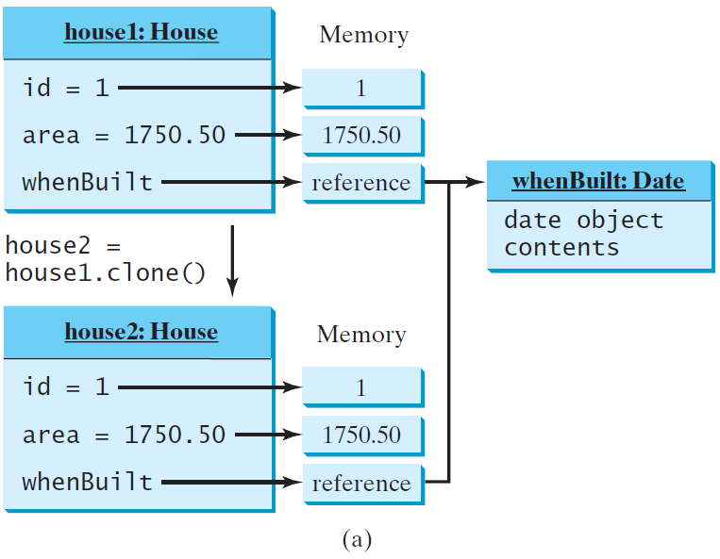
Shallow vs. Deep Copy
House house1 = new House(1, 1750.50);
House house2 = (House)house1.clone();
Shallow Copy
shallow copy: if the field is of reference type, the object’s reference is copied rather than its content.

Slide 43
To perform a deep copy for a House object, replace the clone() method in lines 26–28 with the following code:
Deep Copy
public Object clone() {
try {
// Perform a shallow copy
House houseClone = (House)super.clone();
// Deep copy on whenBuilt
houseClone.whenBuilt = (java.util.Date)(whenBuilt.clone());
return houseClone;
}
catch (CloneNotSupportedException ex) {
return null;
}
}

Slide 44
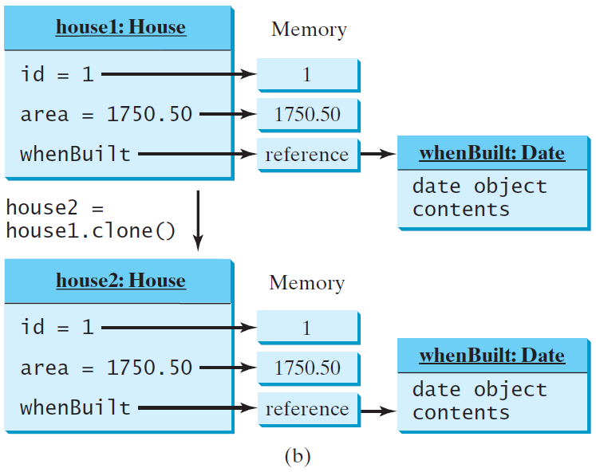
Shallow vs. Deep Copy
House house1 = new House(1, 1750.50);
House house2 = (House)house1.clone();
Deep Copy

Slide 45
Exercise #3: Show the output of the following code:
  java.util.Date date = new java.util.Date();
  java.util.Date date1 = date;
  java.util.Date date2 = (java.util.Date)(date.clone());
  System.out.println(date == date1);
  System.out.println(date == date2);
  System.out.println(date.equals(date2));
True
False
True

Slide 46
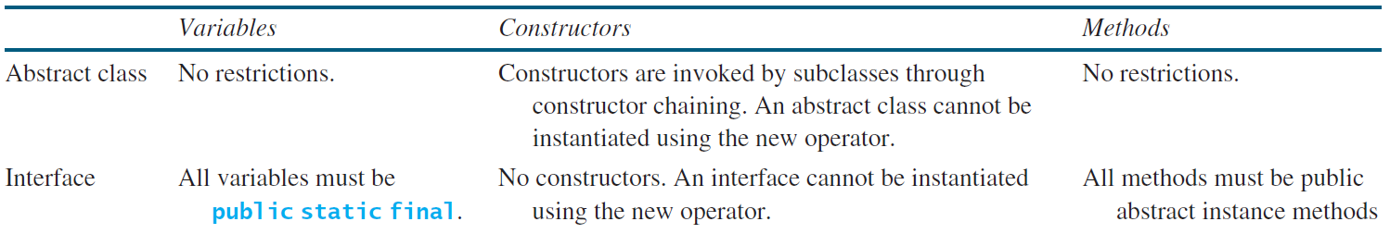
Interfaces vs. Abstract Classes
  A class can implement multiple interfaces, but it can only extend one superclass.
  In an interface, the data must be constants; an abstract class can have all types of data.
  Each method in an interface has only a signature without implementation; an abstract class can have concrete methods.

Slide 47
Interfaces vs. Abstract Classes, cont.
  All classes share a single root, the Object class, but there is no single root for interfaces.
  Like a class, an interface also defines a type.
    A variable of an interface type can reference any instance of the class that implements the interface.
    You can use an interface as a data type and cast a variable of an interface type to its subclass, and vice versa.
  An interface can inherit other interfaces (but not classes) using the extends keyword. Such an interface is called a subinterface.
    If a class extends an interface, this interface plays the same role as a superclass.

Slide 48
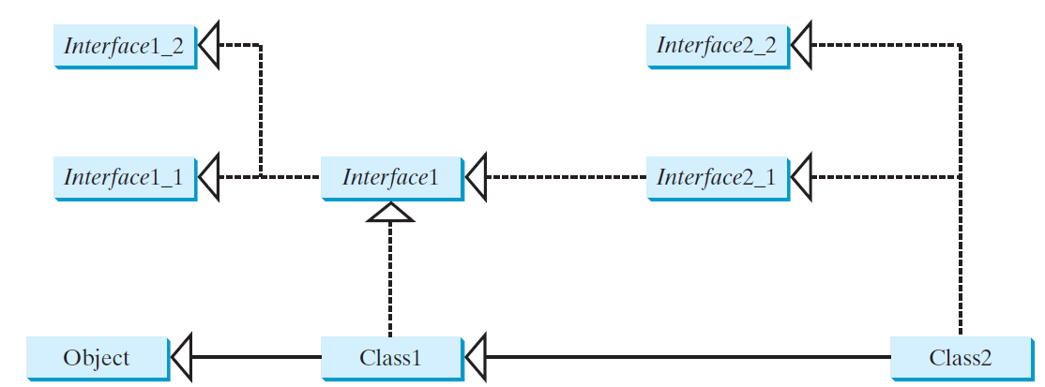
Interfaces vs. Abstract Classes, cont.
  Suppose that c is an instance of Class2.
  c is also an instance of Object, Class1, Interface1, Interface1_1, Interface1_2, Interface2_1, and Interface2_2.
  A class implementing Interface2_1 must implement the abstract methods defined in Interface1, Interface1_1, and Interface1_2.

Slide 49
Caution: conflicting interfaces
  Errors detected by the compiler:
    If a class implements two interfaces with conflict information:
      two same constants with different values,
  or
      two methods with same signature but different return type

Slide 50
Whether to use an interface or a class?
  Abstract classes and interfaces can both be used to model common features.
  How do you decide whether to use an interface or a class?
  In general, a strong is-a relationship that clearly describes a parent-child relationship should be modeled using classes.
    For example, a staff member is a person.

Slide 51
Whether to use an interface or a class?
  A weak is-a relationship, also known as an is-kind-of relationship, indicates that an object possesses a certain property.
  A weak is-a relationship can be modeled using interfaces.
    For example, all strings are comparable, so the String class implements the Comparable interface.
  You can also use interfaces to circumvent single inheritance restriction if multiple inheritance is desired.

Slide 52
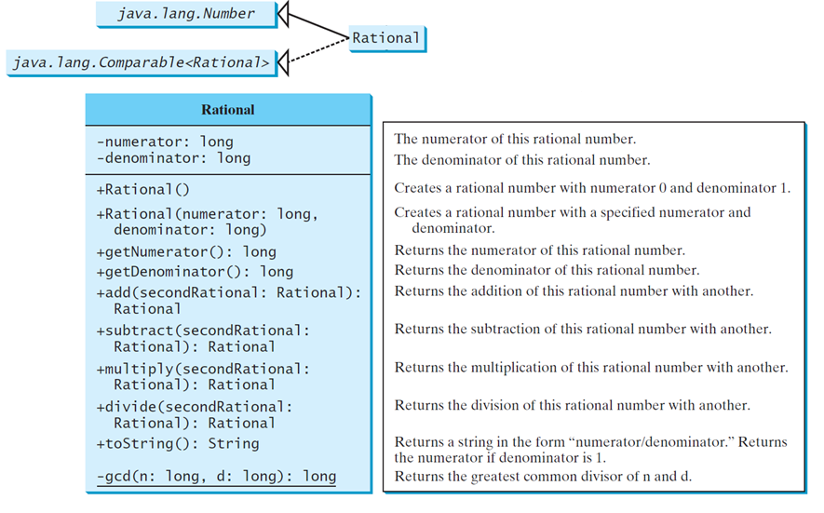
The Rational Class
Rational
TestRationalClass
Run

Slide 53
Class Design Guidelines

Slide 54
Coherence
A class should describe a single entity, and all the class operations should logically fit together to support a coherent purpose.
You can use a class for students, for example, but you should not combine students and staff in the same class, because students and staff have different entities.
Notes:
-You have learned how to design classes from the preceding two examples and from many other examples in the preceding chapters.
-This section summarizes some of the guidelines.

Slide 55
Coherence, cont.
A single entity with too many responsibilities can be broken into several classes to separate responsibilities.
The classes String, StringBuilder, and StringBuffer all deal with strings, for example, but have different responsibilities.
The String class deals with immutable strings, the StringBuilder class is for creating mutable strings, and the StringBuffer class is similar to StringBuilder except that StringBuffer contains synchronized methods for updating strings.

Slide 56
Consistency
Follow standard Java programming style and
naming conventions.
Choose informative names for classes, data
fields, and methods.
A popular style is to place the data declaration
before the constructor and place constructors
before methods.

Slide 57
Consistency, cont.
Always provide a constructor and initialize variables to avoid programming errors.
Provide a public no-arg constructor and override the equals method and the toString method defined in the Object class whenever possible.
In general, you should consistently provide a public no-arg constructor for constructing a default instance. If a class does not support a no-arg constructor, document the reason.

Slide 58
Reuse
Classes are designed for reuse.
Users can incorporate classes in many different combinations, orders, and environments.
Therefore, you should design a class that imposes no restrictions on what or when the user can do with it, design the properties to ensure that the user can set properties in any order, with any combination of values, and design methods to function independently of their order of occurrence.

Slide 59
Encapsulation
A class should use the private modifier to hide its data from direct access by clients. This makes the class easy to maintain.
Provide a getter method only if you want the data field to be readable, and provide a setter method only if you want the data field to be updateable.
A class should also hide methods not intended for client use. The gcd method in the Rational class is private, for example, because it is only for internal use within the class.

Slide 60
Using Visibility Modifiers
Each class can present two contracts – one for the users of the class and one for the extenders of the class.
Make the fields private and accessor methods public if they are intended for the users of the class.
Make the fields or method protected if they are intended for extenders of the class.

Slide 61
Using the static Modifier
A property that is shared by all the instances of the class should be declared as a static property.

